Slide 1
Chapter 14 – Cluster Analysis
Data Mining for Business Analytics
Concepts, Techniques and Applications with JMP Pro
Shmueli, Bruce, Stephens & Patel
© Galit Shmueli, Peter Bruce and Mia Stephens 2016

Slide 2
Clustering: The Main Idea
Goal: Form groups (clusters) of similar records
Used for segmenting markets into groups of similar customers
Example: Claritas segmented US neighborhoods based on demographics and income: “Furs & station wagons,” “Money & Brains”, …

Slide 3
Other Applications
Periodic table of the elements
Classification of species
Grouping securities in portfolios
Grouping firms for structural analysis of economy
Army uniform sizes

Slide 4
Example: Public Utilities
Goal: find clusters of similar utilities
Data: 22 firms, 8 variables
    Fixed-charge covering ratio
    Rate of return on capital
    Cost per kilowatt capacity
    Annual load factor
    Growth in peak demand
    Sales
    % nuclear
    Fuel costs per kwh

Slide 5
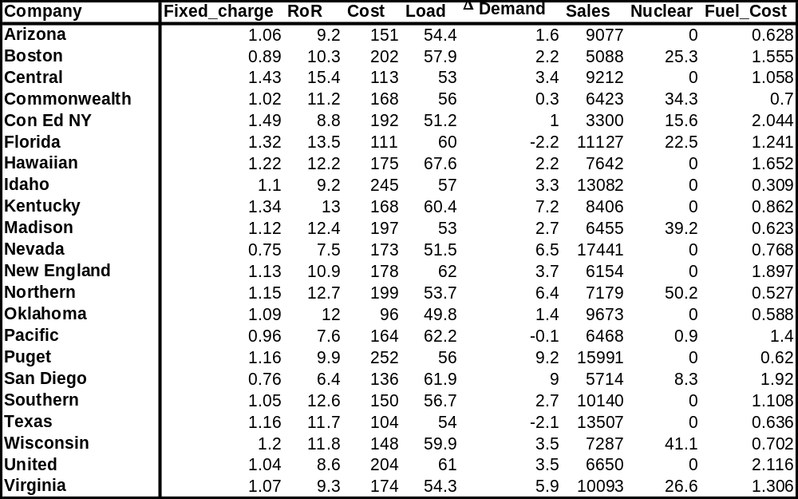
Public Utilities Data

Slide 6
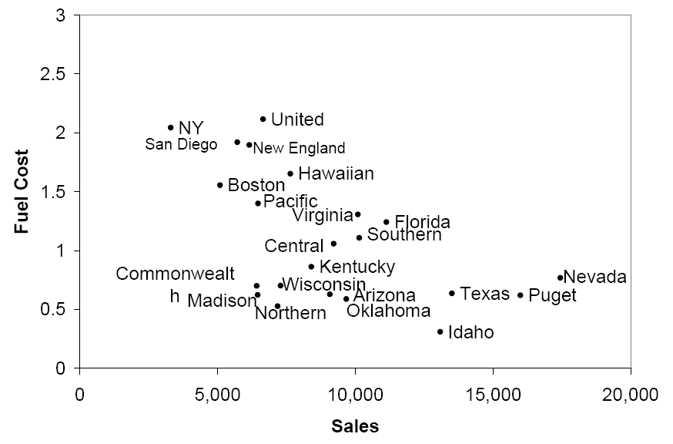
Sales & Fuel Cost:
3 rough clusters can be seen
High fuel cost, low sales
Low fuel cost, high sales
Low fuel cost, low sales

Slide 7
Extension to More Than 2 Dimensions
In prior example, clustering was done by eye
Multiple dimensions require formal algorithm with
  A distance measure
  A way to use the distance measure in forming clusters
We will consider two algorithms:
  hierarchical and
  non-hierarchical

Slide 8
Hierarchical Clustering

Slide 9
Hierarchical Methods
Agglomerative Methods
  Begin with n-clusters (each record its own cluster)
  Keep joining records into clusters until one cluster is left (the entire data set)
  Most popular
Divisive Methods
  Start with one all-inclusive cluster
  Repeatedly divide into smaller clusters

Slide 10
Measuring Distance
Between Records

Slide 11

Distance Between Two Records
Euclidean Distance is most popular:
Name | Age | Height | Weight
Bob | 25 | 72 | 210
Matt | 27 | 68 | 175
Distance =
Distance = 35.26

Slide 12
Normalizing
Problem: Raw distance measures are highly influenced by scale of measurements
Solution: normalize (standardize) the data first
  Subtract mean, divide by std. deviation
  Also called z-scores

Slide 13
Example: Normalization
For 22 utilities:
Avg. sales = 8,914
Std. dev. = 3,550
Normalized score for Arizona sales:
  (9,077-8,914)/3,550 = 0.046

Slide 14
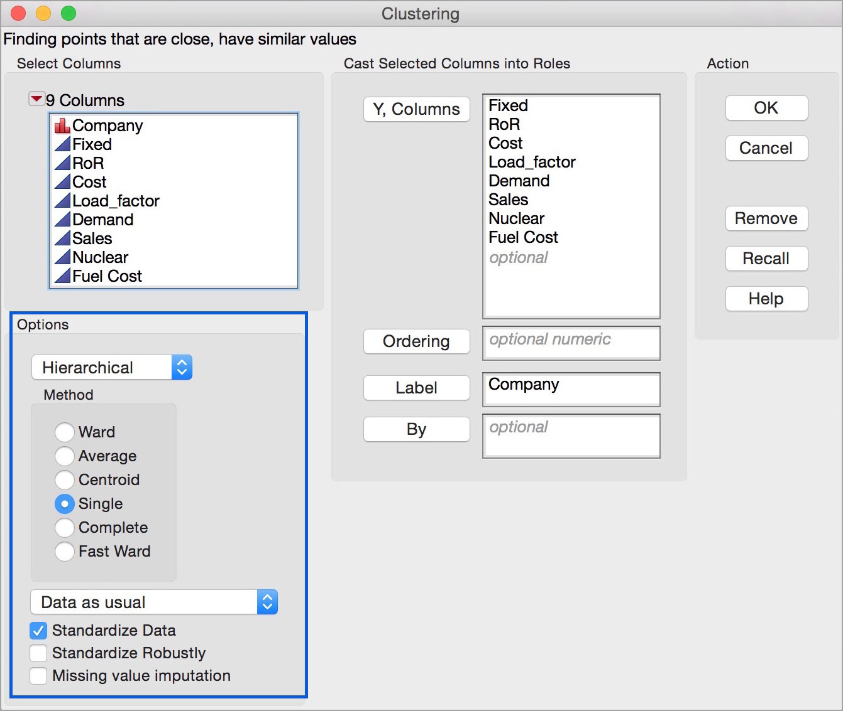
Clustering dialog in JMP
Standardize Data is the default option

Slide 15
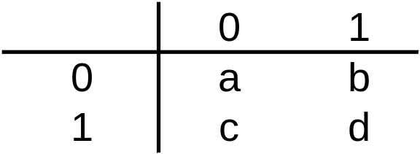
For Categorical Data: Similarity
To measure the distance between records in terms of several 0/1 variables, create table with counts:
Similarity metrics based on this table:
Matching coef. = (a+d)/n
Jaquard’s coef. = d/(b+c+d)
  Use in cases where a matching “1” is much greater evidence of similarity than matching “0” (e.g. “owns Corvette”)

Slide 16
For Categorical Data: Similarity
Name | 4 Yr Degree | Home Owner | Employed | Married | Children
Bob | 0 | 1 | 1 | 1 | 0
Matt | 1 | 0 | 1 | 0 | 0
Bob
Matt
1
2
1
1
Matching coef. = (a+d)/n = (1+1)/5 = 0.4
Jaquard’s coef. = d/(b+c+d) = 1/(2+1+1) = 0.25

Slide 17
Other Distance Measures
Correlation-based similarity
Statistical distance (Mahalanobis)
Manhattan distance (absolute differences)
Maximum coordinate distance
Gower’s similarity (for mixed variable types: continuous & categorical)

Slide 18
Measuring Distance
Between Clusters

Slide 19
Minimum Distance
(Cluster A to Cluster B)
Also called single linkage
Distance between two clusters is the distance between the pair of records A_{i} and B_{j} that are closest

Slide 20
Maximum Distance
(Cluster A to Cluster B)
Also called complete linkage
Distance between two clusters is the distance between the pair of records A_{i} and B_{j} that are farthest from each other

Slide 21
Average Distance
Also called average linkage
Distance between two clusters is the average of all possible pair-wise distances

Slide 22
Centroid Distance
Distance between two clusters is the distance between the two cluster centroids
Centroid is the vector of variable averages for all records in a cluster

Slide 23
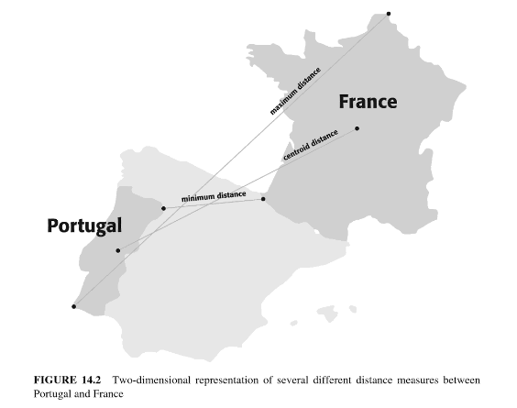
Distance Measures

Slide 24
Ward’s Method
Considers loss of information when observations are clustered together
Uses error sum of squares (ESS) to measure the difference between observations and the centroid
The Fast Ward method in JMP is more efficient, and is used automatically for large data sets

Slide 25
The Hierarchical Clustering (Using Agglomerative Method)
Steps:
Start with n clusters (each record is its own cluster)
Merge two closest records into one cluster
At each successive step, the two clusters closest to each other are merged
Dendrogram, from left to right, illustrates the process

Slide 26
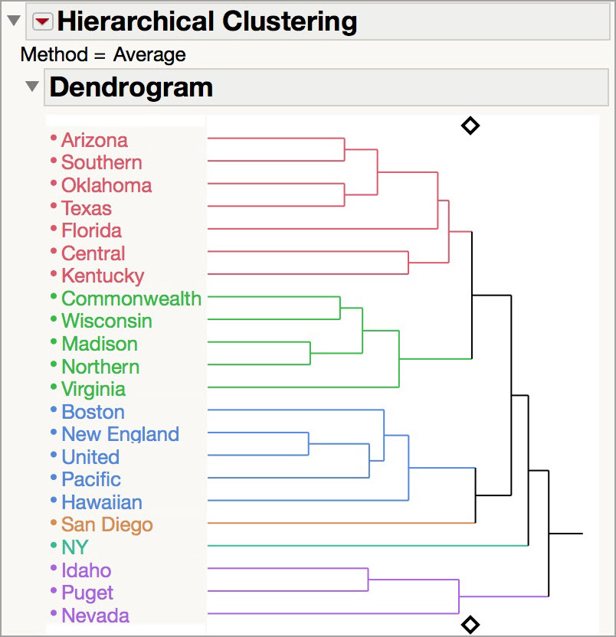
Dengrograms
New England and United are closest and form the first cluster
The second cluster is Madison and Northern
Vertical lines connect the clusters

Slide 27
Validating Clusters

Slide 28
Interpreting Clusters
Goal: obtain meaningful and useful clusters
Caveats:
  (1) Random chance can often produce apparent clusters
  (2) Different cluster methods produce different results
Solutions:
Obtain summary statistics
Also review clusters in terms of variables not used in clustering
Label the cluster (e.g. clustering of financial firms in 2008 might yield label like “midsize, sub-prime loser”)

Slide 29
Desirable Cluster Features
Stability
  Are clusters and cluster assignments sensitive to slight changes in inputs?
  Are cluster assignments in partition B similar to partition A?
Separation
  check ratio of between-cluster variation to within-cluster variation (higher is better)

Slide 30
Nonhierarchical Clustering:
K-Means Clustering

Slide 31
K-Means Clustering Algorithm
Choose # of clusters desired, k
Start with a partition into k clusters
    Often based on random selection of k centroids
At each step, move each record to cluster with closest centroid
Recompute centroids, repeat step 3
Stop when moving records increases within-cluster dispersion

Slide 32
K-means Algorithm:
Choosing k and Initial Partitioning
Choose k based on the how results will be used
  e.g., “How many market segments do we want?”
Also experiment with slightly different k’s
Initial partition into clusters can be random, or based on domain knowledge
  If random partition, repeat the process with different random partitions

Slide 33
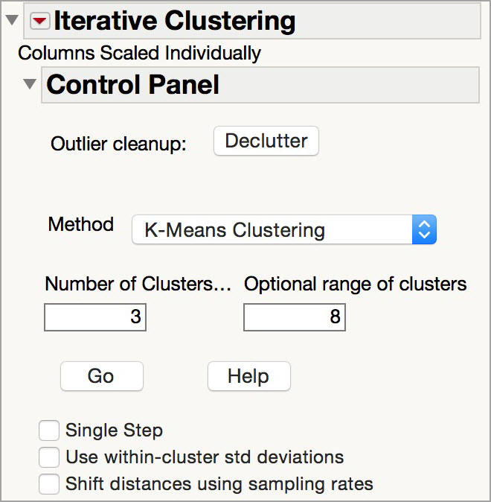
K-means dialog in JMP
Try a range of values for k

Slide 34
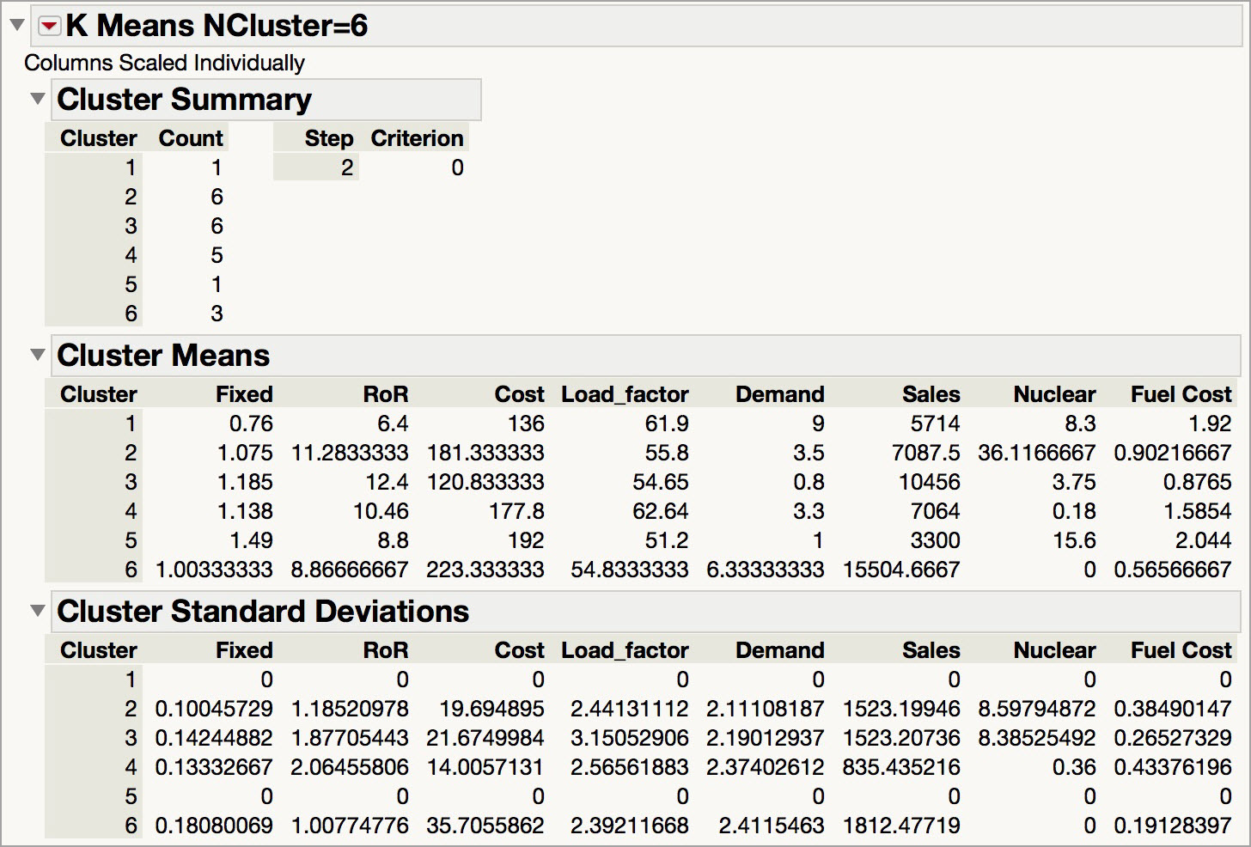
K-means output (k = 6)

Slide 35
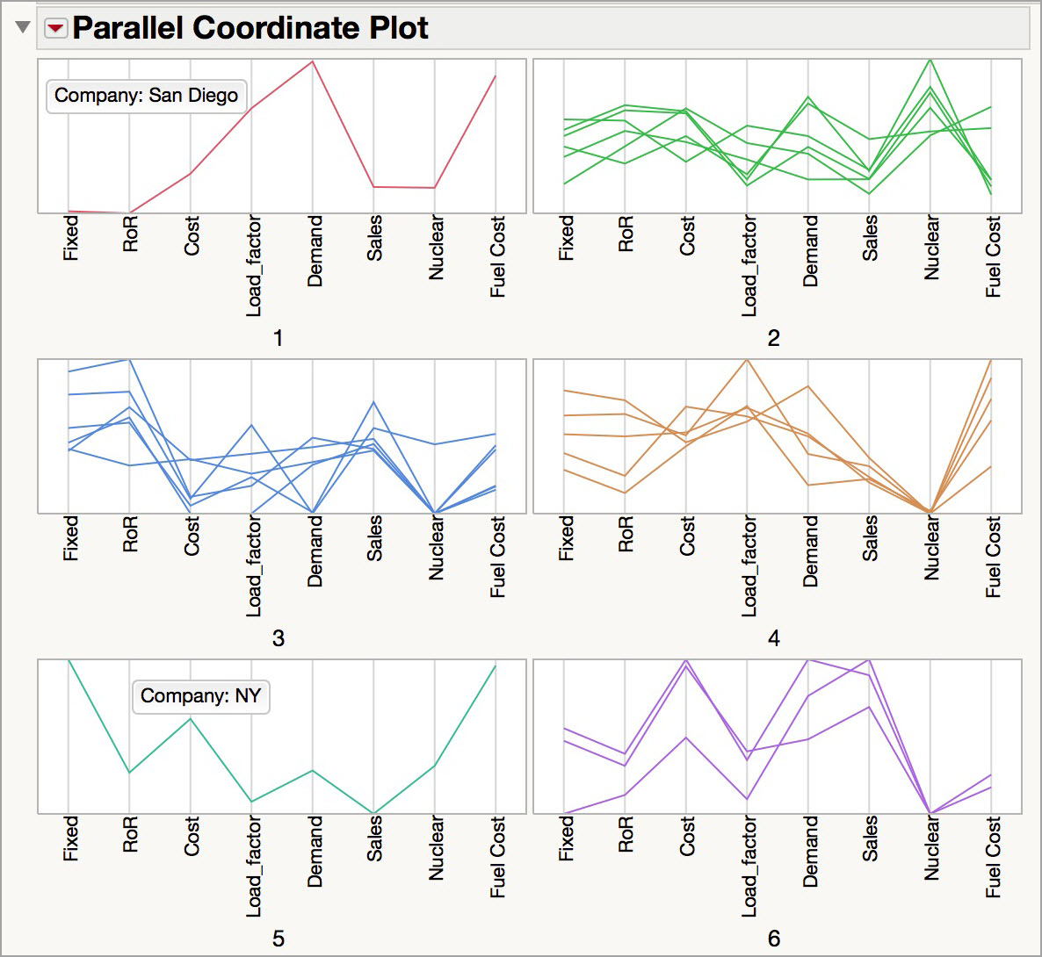
Visualizing Clusters
Parallel Plot shows the number of records per cluster, and the profile of the clusters across the variables

Slide 36
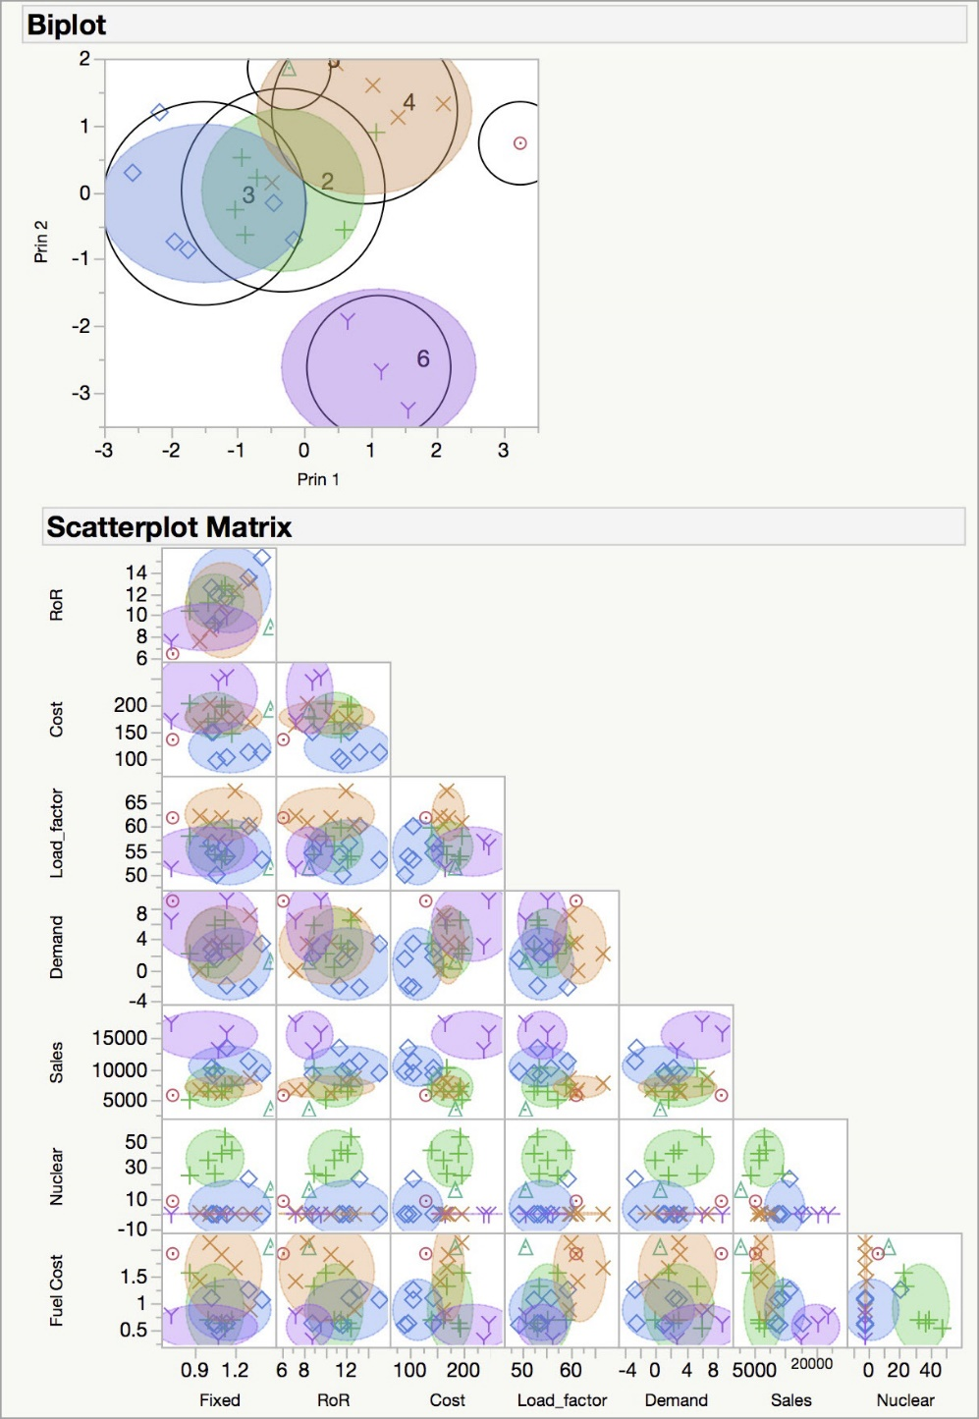
Visualizing Clusters
Biplot shows separation and overlap of the clusters
Scatterplot matrix shows separation of the clusters across the variables

Slide 37
Summary
Cluster analysis is an exploratory tool
It is useful only when it produces meaningful clusters
Hierarchical clustering gives visual representation of different levels of clustering
Non-hierarchical clustering is computationally cheap and more stable (good with larger data sets); requires user to set k
Can use both methods
Be wary of chance results; data may not have definitive “real” clusters

